Slide 1

Office Ergonomics
NAVFAC
2023

Slide 2
Review of Ergonomic Risk Factors
Office Ergonomics
Desk
Work Surface
Chair
Monitor
Illumination
Laptops
Keyboards
Input Devices
Telephone

Slide 3
Course Overview
Resources for Workstation Evaluation and Assessment
OPNAVINST 5100.23 Chapter 23-Physical Risk Factor Ergonomic
  Checklist
Office Assessment Indicators
Computer/Electronic Accommodation Program (CAP)

Slide 4
Office Ergonomics Workstation Review

Slide 5
Ergonomic Risk Factors
Posture
Compression
Force
Repetition
Vibration
Duration
Temperature

Slide 6
Ergonomic Risk Factors
These ergonomic risk factors are usually found in an office setting:
Posture
  Non-neutral postures can put the hands, arms, wrists, neck, shoulders and legs at risk for Work-related musculoskeletal disorders (WMSDs)
Compression
  Contact stress on thighs, arm and palms
Force
  Static muscle loading
Repetition
  Some tasks can cause highly repetitive motions with little recovery time
Duration
  Visual demands from constant attention
Temperature
  Cold computer rooms can impede blood flow

Slide 7
Office Ergonomics
Steady typing involves heavy repetition with little opportunity for muscle recovery and inadequate recovery time leads to fatigue.
Computer tasks can often be visually demanding. Stress and requirements for constant attention are contributing factors.
Many offices are kept at cold temperatures for the sake of equipment. Cold temperatures are also a risk factor.

Slide 8
Office Desk
The desk dictates the height of the monitor,
keyboard and mouse and has a direct impact on posture.
How can we help the desk fit the widest range of users?
Desk risers.
Adjustable chairs.
Sit/stand workstations.

Slide 9
Sit/Stand or Adjustable Desk
An adjustable desk allows the user to alternate sitting and standing.
Provides alternative posture for workers with back problems.
Benefits
  Minimizes fatigue or discomfort associated with continuous sitting or standing.
Cons
  Potential for stress on lower back resulting from static standing posture.

Slide 10
Work Surface Evaluation
Work surfaces and desks should be appropriately height-adjusted to provide proper placement of computer components and accessories, and allow for adequate leg clearance facilitating neutral postures.
Place frequently used items closer to the body to minimize reaching.

Slide 11
Work Surface Evaluation
Limited work surfaces may lead to non-neutral, awkward postures.
  Reaching for a mouse.
  Looking to the side at the monitor.
Storing items underneath a desk restricts available leg space.
Worker may not be able to sit aligned with the monitor in front of them.

Slide 12
Work Chair
For many office workers, the chair is the most critical piece of furniture. No one chair will fit everyone, therefore it is important to select a chair with adjustable features.
Many chairs come in different sizes to accommodate all individuals.

Slide 13
Work Chair
A worker larger than the 95th percentile in size or weight may need a different size chair that is made of sturdier materials.
For a tall person, the adjustable height may be stretched to the point where forward/backward motion in the seat could cause the seat pan to snap.
Often smaller workers cannot get the chair to "shrink small enough" where their feet touch the floor or their elbows can contact the armrests in a neutral posture.
Letting workers try chairs before purchasing them may improve user acceptance and comfort.

Slide 14
Work Chair Features
Lumbar support/Backrest tilt
Armrests
Seat height
Swivel 360 degrees
Seat pan/ Seat pan tilt
Height Adjustable
5-leg base with
appropriate casters

Slide 15
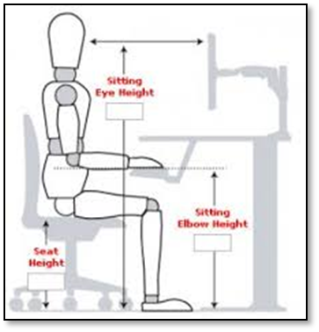
Work Chair Adjustment
Seat Height:
  Allow the hands to be at a 90⁰ angle while working.
  Feet should be supported by the floor or footrest.
Chair Back:
  Correct placement of the lumbar support.
  Lumbar support on the chair should be located at seated elbow height.

Slide 16
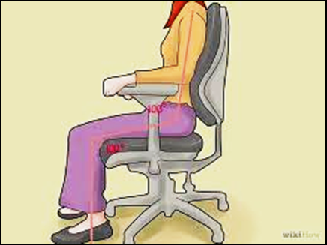
Work Chair Adjustment
Seat Pan:
  Rounded water fall edge is preferred.
  The seat pan is wider than the person's hip breadth.
Armrests:
  Shoulders should be relaxed when the elbows are on top of the armrests.
  Elbows should be under shoulders.

Slide 17
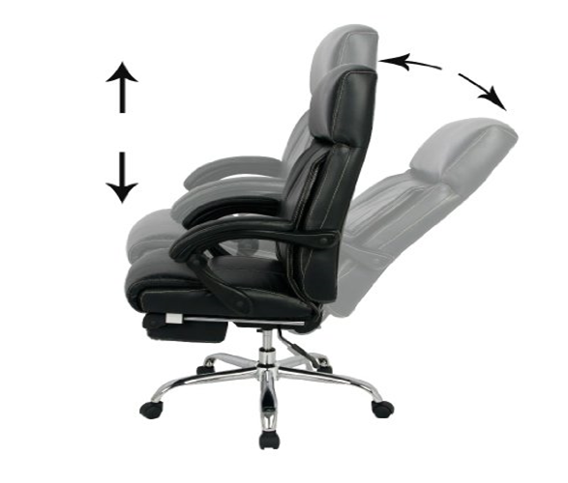
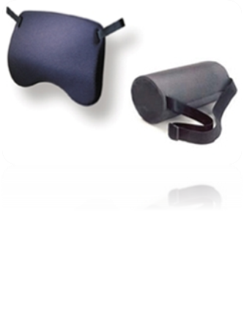
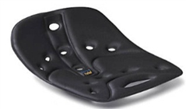
Work Chair Adjustments
Lumbar and back support:
  Backrest or lumbar area should be independently adjustable.
  Lumbar support should be pronounced and fit the contour of the user's back.
External accessories:
  Lumbar rolls
  Orthotic seat cushions.

Slide 18
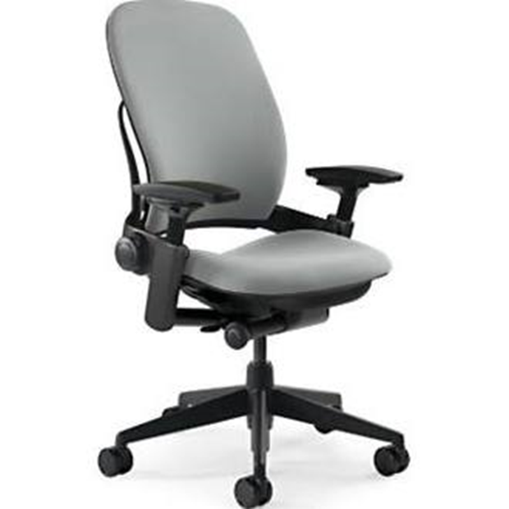

Work Chair Adjustments
Arm Support
  Should have adjustable height, width and angle rotation.
  Maintain user's elbows at a neutral position by their side with shoulders relaxed.
  Should not prevent the user from getting close to their work station.

Slide 19
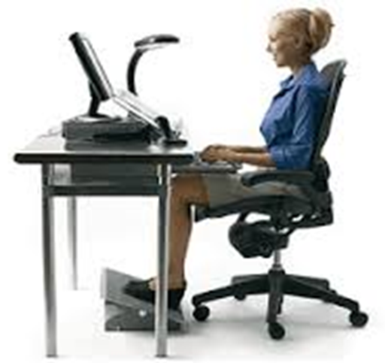
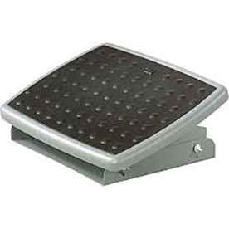
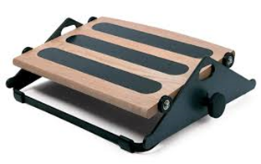
Foot Rest
Used to raise floor for shorter workers, helps to decrease contact stress on thighs.
Helps back posture by encouraging use of the chair backrest.
Keeps legs at proper angle.
Supports feet.

Slide 20
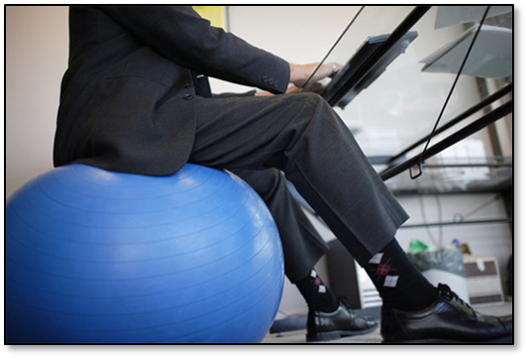
Exercise Balls as Office Chairs
Benefits:
  Increase core strength since abdominal muscles are constantly engaged.
Risks:
  Does not provide arm support.
  Increase fatigue, low back and neck pain.
  Ball can roll and pose additional hazards based on work environment.
NOTE: Alternative seating such as exercise balls,
ball chairs, kneeling chairs, etc. are not
considered acceptable office seating for the
typical work activity. See reference e of
OPNAVINST 5100.23 Chapter 23 for chair
purchasing guidelines.

Slide 21
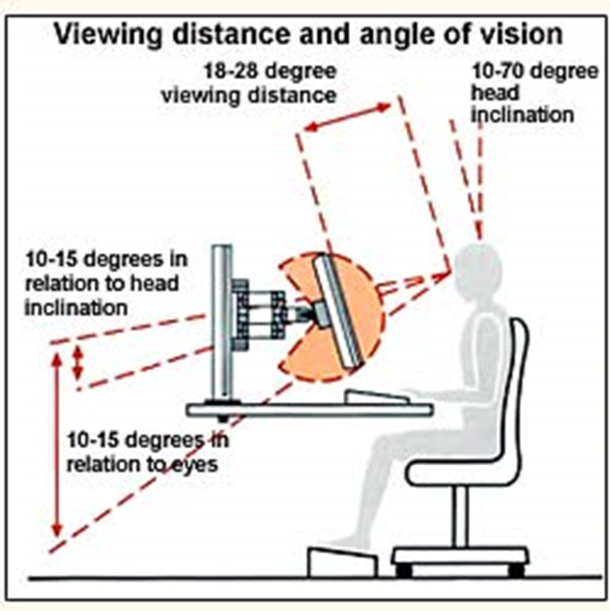
Monitors - Distance and Location
Monitor Distance:
  Depends on font size and eyesight.
  Arms length away with the arm straight out to touch screen (20"-26").
Monitor Location:
  Directly in front of the user to avoid excessive twisting of the neck.
  Inline with the keyboard.
  Positioned so no twisting is required.

Slide 22
Monitors - Other Considerations
Make sure the surface of the viewing screen is clean.
Adjust brightness and contrast to optimum comfort.
Tilt top of the monitor back 10 to 20 degrees.
Monitors should be located slightly lower than eye level if the worker wears bifocals or trifocals.
Position monitors at right angles from windows to reduce glare.
Position monitors away from direct lighting which cerates excessive glare or use a glare filter over the monitor to reduce glare.
If you use a large monitor (20" or larger), position your monitor so that the top of the viewing area is about 3" above eye level.
Computer glasses can be worn to assist with computer work where the range of focus is in the 18"-30" range between our near and far vision.

Slide 23
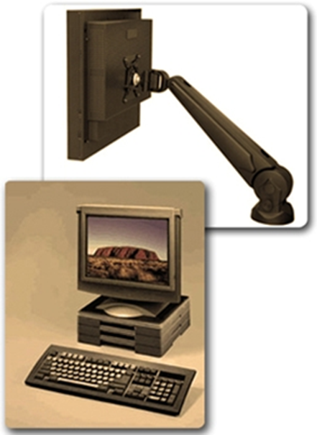
Monitor Accessories
Monitor arms are useful when:
  Desk space is limited.
  Monitor is used some of the time.
  Monitor is viewed from a variety of
  heights and angles.
  The monitor is viewed from both a
  seated and standing position.
Monitor risers are recommended
when the viewing height is too low.
  Risers in 1" increments are recommended to allow for the best height to be found.

Slide 24
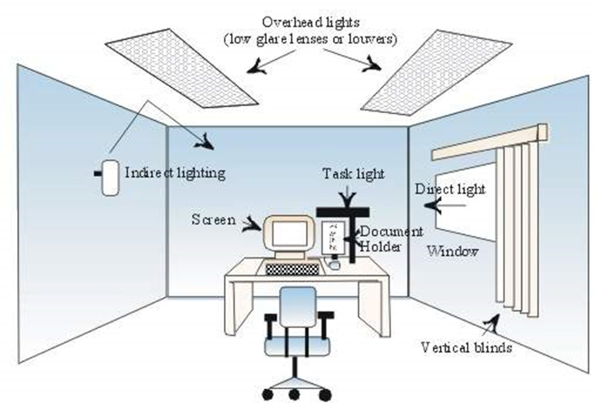
Illumination
Use louvers to diffuse light.
Place monitor perpendicular to windows.
Use blinds to cover windows if needed.
Use indirect lighting as much
as possible to reduce glare.
Place monitor parallel and in
between overhead light fixtures.
Add task lightening as needed.

Slide 25
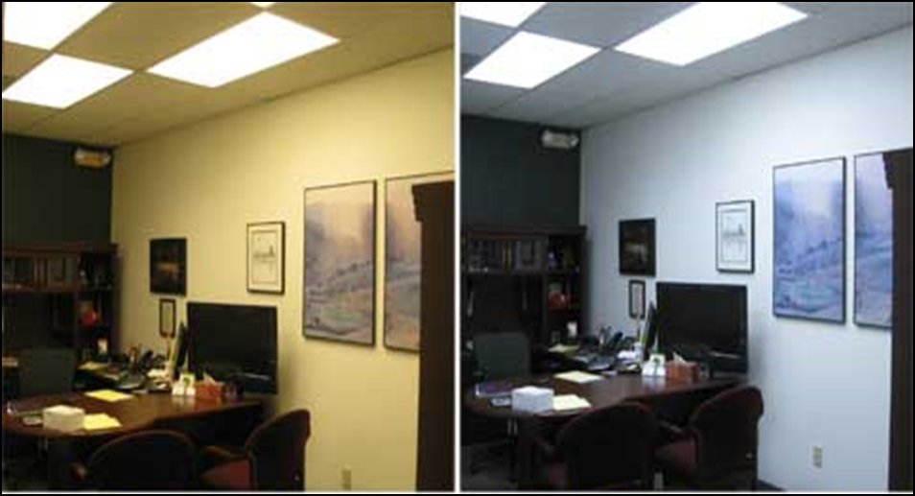
Illumination
Light from different sources will make objects appear differently. Full spectrum lighting mimics natural sunlight. It is cleaner light and easier on the eyes.
      Fluorescent Full Spectrum

Slide 26
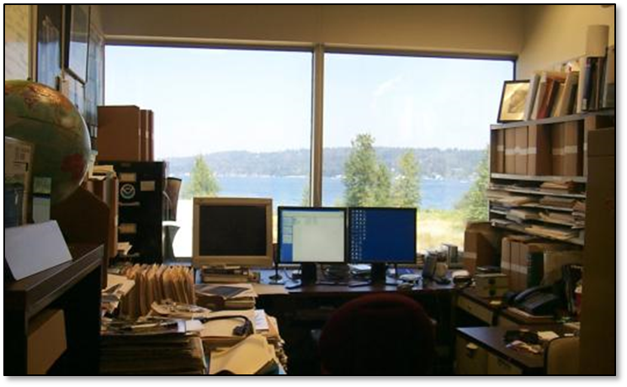
Illumination Issues - Direct Glare
Vision is reduced when the light source directly hits the eyes.
Sitting in front of a window without blinds or a shade is the most common source of direct glare in an office setting.

Slide 27

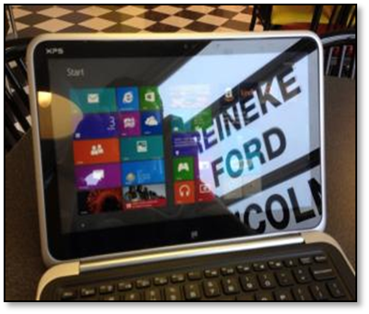
Illumination Issues - Indirect Glare
Glare is caused by the light source reflecting off a surface then hitting the eyes.
Monitor placement can influence the amount of glare to which the user is exposed.

Slide 28
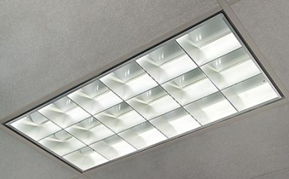
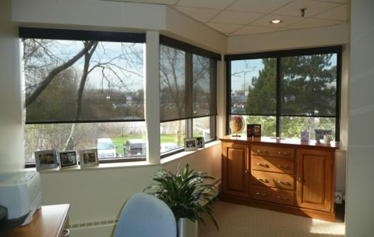
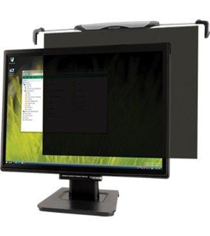
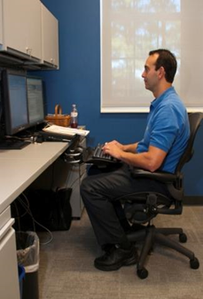
Glare Control
Light fixtures with parabolic louvers
At the light source
At the location
By monitor location

Slide 29
Eye Strain
Eye strain is the number one complaint of computer users. Approximately 10 million people suffer computer monitor related vision problems.
  Risk factors:
    Poor lighting
    Glare
    Poor eyesight
    Use of bi- and trifocals.
    Screen angle, height and placement.
    Long hours of computer use.
    Screen images with poor resolution.
    Use of more than one video monitor at the same workstation.
  Back, shoulder and neck pain may be related to poor posture due to vision problems.

Slide 30
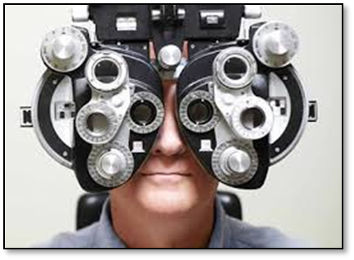
Eye Strain
Good ergonomic habits:
  The 20-20-20 rule:
    Every 20 minutes take 20 seconds to look at an object at least 20 feet away.
    Blink or use eye drops.
    Keep the monitor screen clean.
    Keep regular vision care.

Slide 31
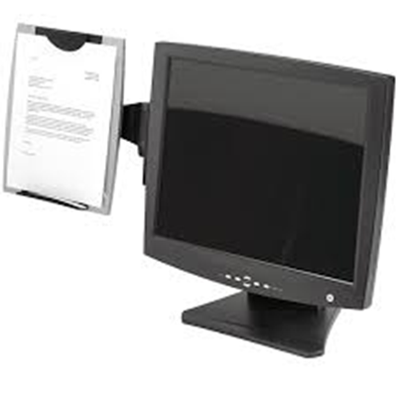
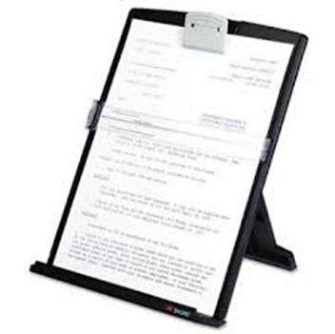
Document Holders
Help reduce non-neutral neck postures, fatigue and eye strain.
Positioned adjacent to the monitor and approximately the same height, distance and angle as the monitor.

Slide 32


Laptops
Laptop usage can cause musculoskeletal
discomfort, the fixed design and the lack of
separation between the keyboard and the monitor.
The optimal position for a keyboard is in front of
the user, but often in that position your eyes are
looking down to see the screen.
Long term use can cause problems because it is
a trade off between poor neck/head posture, or
poor hand/wrist posture.
Poor work locations like working in bed or
on a couch are not recommended.

Slide 33
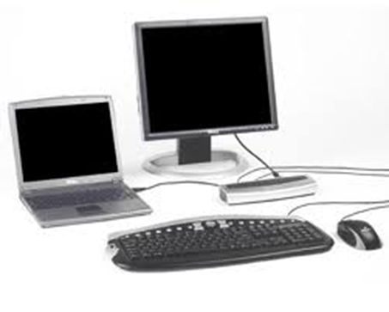
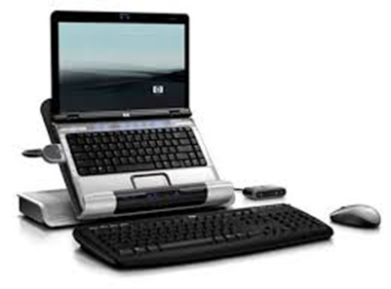
Laptops
If a laptop is used at your desk the best option is to plug it into a docking station and use a separate keyboard, mouse, and monitor. This is the best option for a long term laptop use.
Laptop use has been associated with poor
back, neck, and upper extremity posture.
Improve posture by using:
  Docking stations.
  Full size mouse.
  Full size keyboard
  Monitor stand.

Slide 34


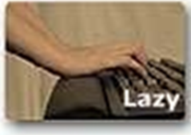

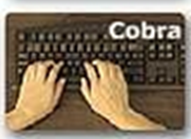
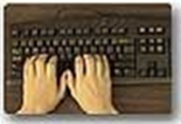
Keyboards
  Bad Practices
Good Practices
Computer users who lean forward often assumes this posture. This tends to produce pain in the back of the hand and wrist. The hand's strong functional curve is also lost.
A natural curvature of the hand.
Good hand position "floats" over the keyboard.
Resting on a wrist rest or table forces the hand from its natural curvature and places stress on the fingers and tendons.
Keeping the elbows near the body can be less stressful.
Elbows bent out away from the body and twisting the wrists causes stress in the forearms, hands, and wrists.

Slide 35
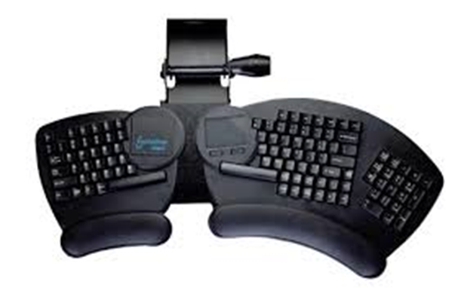
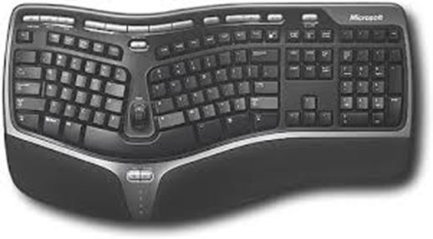
Keyboard Alternatives
Intended to reduce wrist deviations.
Requires a learning curve. Some designs require more training than others.
Inconclusive scientific evidence as to whether alternative keyboards prevent WMDSs.
These keyboards are not helpful if you are not a touch-typist.

Slide 36
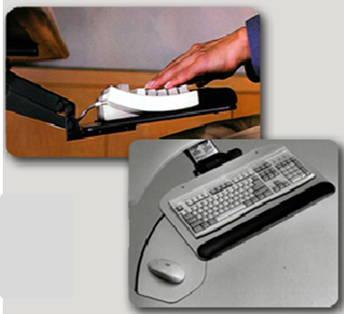
Keyboard Trays
Desired features include:
  Room for a mouse.
  Retractable, height adjustable arm.
  Keyboard and mouse at the same level.
  Allow wrists to be in a straight/neutral posture.
  Slightly negative tilt on the keyboard.

Slide 37
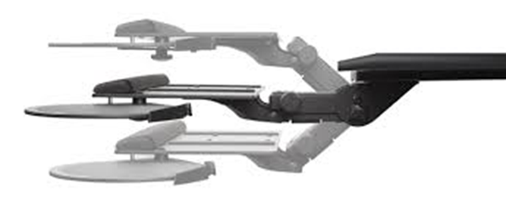
Keyboard Trays
Preferred options are:
  Knob - and lever-free adjustments.
  Ability to swivel 360⁰ at the desk and the keyboard.
  Ability to accommodate both left and right handed mouse users.
  Height adjustment to accommodate seated and standing work.
  Slim profile to avoid knee contact.

Slide 38
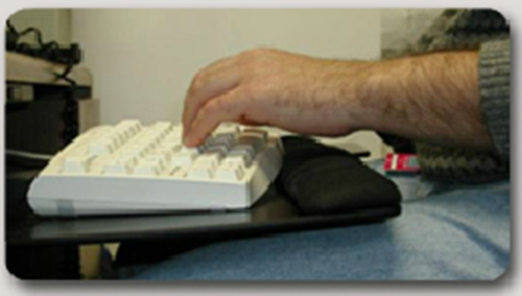
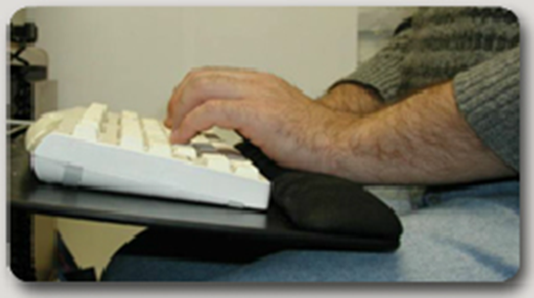
Wrist Rests
Wrists should not rest on wrist rests while typing. They are only to be used during rest.
If used improperly, wrist rests can contribute to stress and increase pressure in the carpel tunnel.
Proper wrist position with downwardly tilted keyboard and neutral "floating" wrist posture.
Improper wrist position with upward keyboard slope and wrist extension.

Slide 39
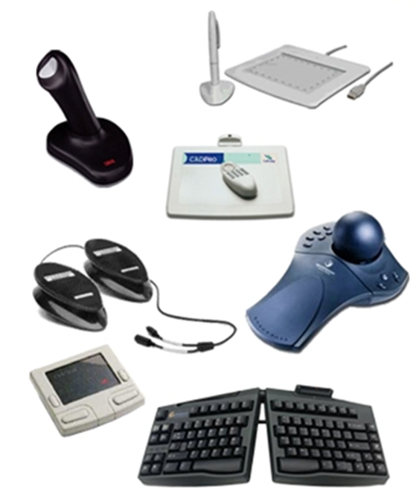
Input Devices
Many different options for data input devices are available and new designs are being developed. The selection of an input device is related to personal preference and the task (e.g. graphic designers may prefer a special tablet pad).
The input device should fit the hand of the user with minimal use of force.
Alternative input devices (like a foot operated mouse) are important for people with special needs.
Maintenance is important to reduce force required.

Slide 40
Input Devices - Contraindications
Consider limiting conditions when selecting an alternative input device. Some input devices can aggravate existing conditions.
  Do not select a thumb-operated trackball if the worker has DeQuervain's syndrome or another WMSD affecting the thumb.
  Do not select a novel keyboard design if the worker cannot touch-type or if the worktable height is not optimal.
  Consider a trackball if there is not adequate workspace to operate a mouse.
  Consider an input device that utilizes a large grip if the worker cannot use a pinch grip due to dexterity or force issues.

Slide 41
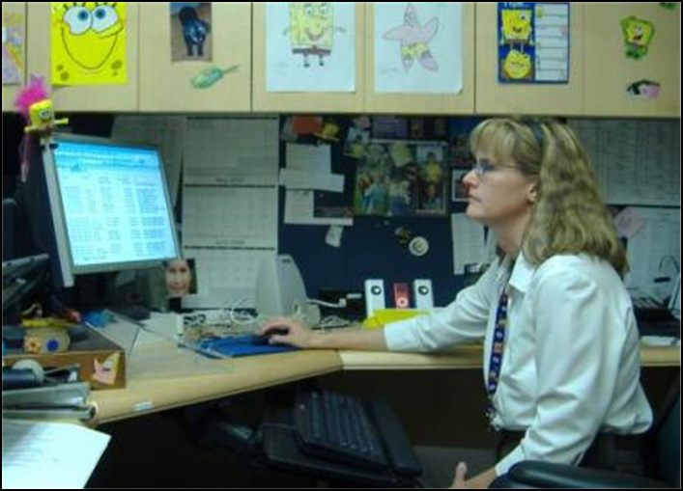
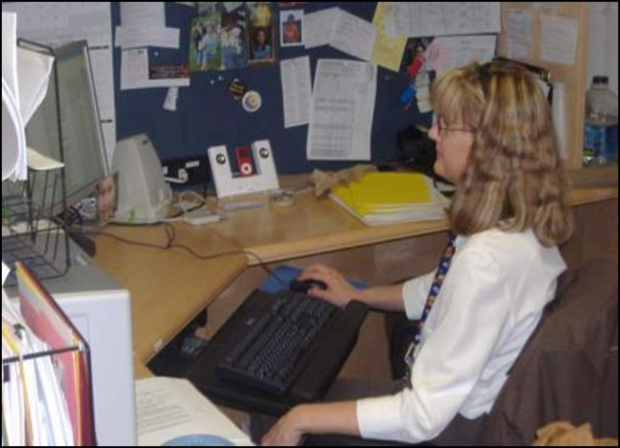
Mouse Location
When the mouse is too far away the shoulder and neck muscles are often overtaxed.

Slide 42
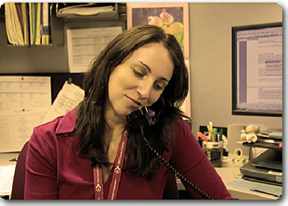
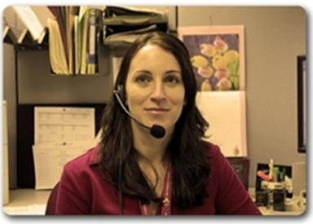
Telephone Headsets
Important for people who:
  Write or use the computer while talking on the phone.
  Are on the phone for extended periods or receive frequent calls.
Cradling the phone with a non-neutral, awkward neck posture causes compression or contact- stress in the neck and shoulder.
Stereo headsets block extraneous noise while mono headsets allow users to maintain awareness of their surroundings.
A noise-canceling microphone filters phone and room noise keeping communications clear and free of background noises.

Slide 43
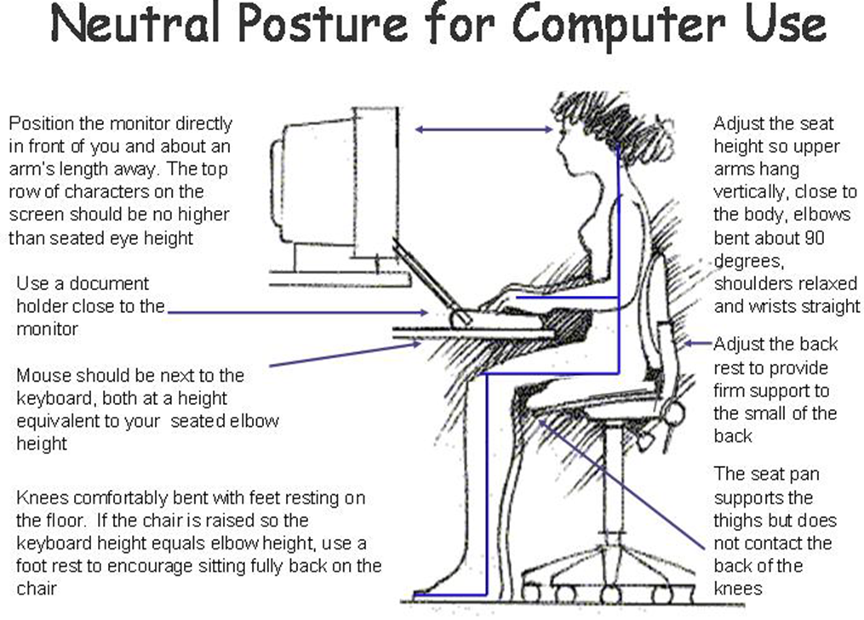
5100.23 Chapter 23 Appendix B23-A
The information in the figure accommodates 90% of the population.

Slide 44
Tip: 1) Taking 20 second micro-breaks throughout the day to refocus your eyes will reduce fatigue at the end of the day. 20/20 rule: for every 20 minutes of work, rest the eyes 20 seconds.

Slide 45
Physical Risk Factor Ergonomic Checklist
The Physical Risk Factor Ergonomic Checklist is a tool used in work places to identify and evaluate ergonomic stressors. The checklist can be used for typical work activities, which are a regular and foreseeable part of the job, occurring more than one day per week, and more frequently than one week per year.
For each category determine whether the physical risk factors rate as a “caution” or “hazard” by placing a check () in the appropriate box. Note if a category is not applicable.
If a work place “hazard” exists, it must be reduced below the hazard level or to the degree technologically and economically feasible. Ensure workers exposed to ergonomic stressors at or above the “hazard” level receive general ergonomics training.
If the task rates a “caution,” then it should be periodically reassessed since changes in the work environment may create new ergonomic stressors. A work activity that is found to be a “caution or hazard” should be evaluated further.
Physical Risk Factors Ergonomic Checklist: https://intelshare.intelink.gov/sites/nsc/OnOffDuty/Ergonomics%20Job%20Requirements%20and%20Physical%20Demands%20Survey.pdf#search=ergonomics

Slide 46
Physical Risk Factor Ergonomic Checklist continued
Ensure significant contributing physical or personal risk factors are not present. Contributing factors contribute to but do not cause Work-related Musculoskeletal Disorders. Physical contributing factors may include temperature extreme, inadequate recovery time, and stress on the job.
Non-occupational factors (personal contributing factors) may include but are not limited to age, pregnancy. obesity, wrist / knee / ankle strain or fracture, back strain, thyroid disorder, rheumatoid arthritis, hypertension, diabetes, kidney disorders, gout; as well as tendonitis / tenosynovitis, epicondylitis, thoracic outlet syndrome, ganglion cyst, bursitis, trigger finger, and carpal tunnel syndrome. Professional judgment should be used in instances where personal or physical contributing factors are present.
Also, note that the risk of developing a Work-Related Musculoskeletal Disorder increases when ergonomic risk factors occur in combination.
Physical Risk Factors Ergonomic Checklist: https://intelshare.intelink.gov/sites/nsc/OnOffDuty/Ergonomics%20Job%20Requirements%20and%20Physical%20Demands%20Survey.pdf#search=ergonomics

Slide 47
Hand Tool Selection Checklist
This checklist helps identify hand-held tool designs that have minimal health effect on the user.
An answer of “NO” to any of the tool category questions is an indication that the tool should be further evaluated before being purchased. A checklist must be filled out for every type of tool purchased or evaluated. The shop evaluator or reviewer must request assistance from the Occupational Safety and Health Department prior to procurement of the tool being evaluated if there are any questions regarding the questions below or if there is any sign of ergonomic hazards. An alternative should be pursued for any tool that is shown to present an ergonomic hazard.
Guide to selecting non-powered hand tools:

Slide 48
Ergonomic considerations for shift workers
Shift work is a risk factor for several medical disorders, poor performance and decreased vigilance. The times required of shift work conflicts with normal human biological rhythms.
Time is needed for body temperature and performance rhythms to adjust to work cycles.
Two to 3 weeks are required for complete adjustment of the temperature rhythm to a complete day-night reversal (a 12-hour time shift).
The most frequent problem for night workers, is chronic sleep deprivation. Affected workers get fewer hours of total sleep and much of that sleep is disrupted.
Shift workers schedules should be rotated forward, workers find it easier to adjust to a phase delay rather than a phase advance.
At least 48 hours should follow the night shift rotation.
Overtime should be avoided for personnel adjusting to time shifts.

Slide 49
Computer/Electronic Accommodation Services (CAP)
Services and Support
CAP’s Mission:
  Provide assistive technology and accommodation to support individuals with disabilities and wounded, ill and injured Service Members throughout the Federal Government in accessing information and communication technology.
  Provide free assistive technology and associated training.
  Conduct free comprehensive needs assessments and technology demonstrations.
  Provide training on disability program management and on creating an accessible environment.
  Support the compliance of federal regulations.

Slide 50
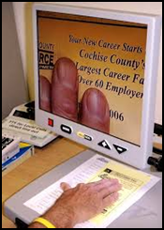
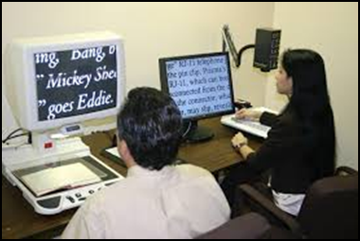
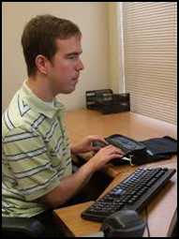
Computer/Electronic Accommodation Program (CAP)
The Workplace Ergonomics Reference Guide provides illustrations of proper workstation ergonomics and a checklist for implementation of these strategies as well as tips for prevention of repetitive stress injuries.
CAP works to ensure that people with disabilities have equal access to the information environment and opportunities in the Department of Defense and throughout the Federal Government.
While CAP's focus is to provide assistive technology to accommodate people with a disabling condition, such as carpal tunnel syndrome (or other repetitive stress injuries), CAP prefers to take a proactive approach to these issues by educating customers on prevention of the repetitive stress injuries that can result from workstations that lack proper ergonomic configuration.

Slide 51
Computer/Electronics Accommodation Program (CAP)
If you have further questions or need further assistance, you may contact CAP main office:
  (833) 227-3272 or (703) 614-8416 (voice)
  Email cap@mail.mil
Computer//Electronic Accommodations Program Technology & Evaluation Center (CAPTEC) for assessments and evaluations:
(703) 693-5160 (voice)
  Email cap.captec@mail.mil

Slide 52
Let's try some workstation evaluations

Slide 53
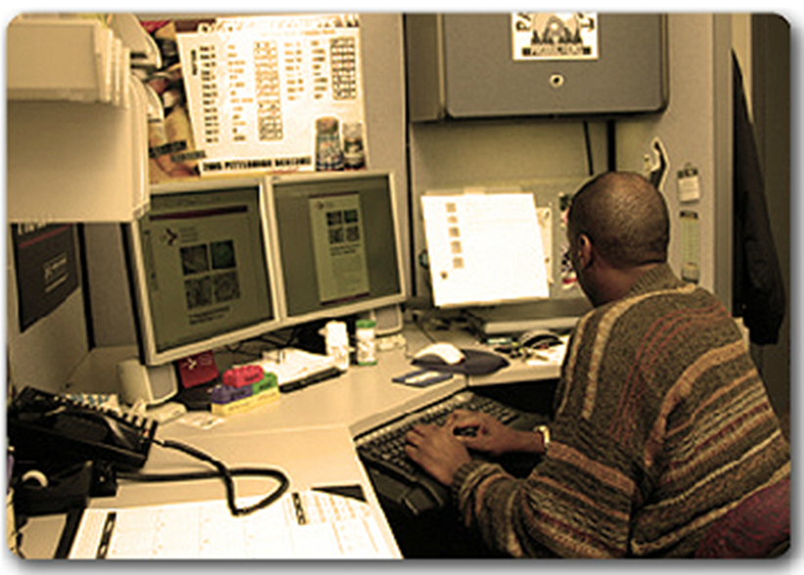

Workstation Evaluation Activity #1
Does this workstation meet the criteria to allow the individual to work in the neutral position?
  Meets criteria
Neck bent and twisted to the side
Head and trunk is leaning forward
Monitor screen is above eye level
Monitor is closer than 24 inches
Glare on the paper held in the document holder
Does not meet criteria

Slide 54
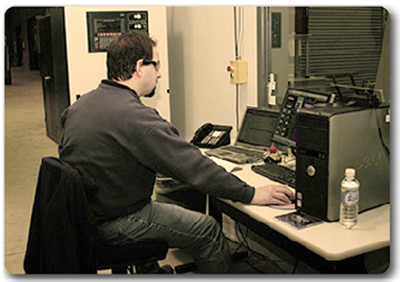
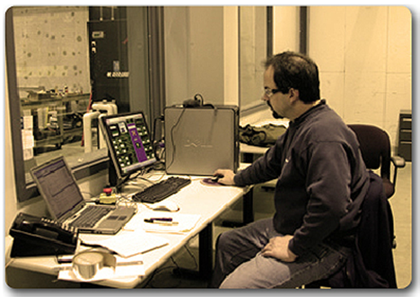

Workstation Evaluation Activity
Does this workstation meets the criteria to allow the individual to work in the neutral position?
Meets criteria
Does not meet criteria
Does not meet criteria
Notes:
Shoulders and upper arms not in-line with the torso
Upper arms and elbows are not close to the body but extended out to the mouse
Forearms, wrists and hands are not straight and in-line, rather his right wrist appears bent at an awkward angle

Slide 55
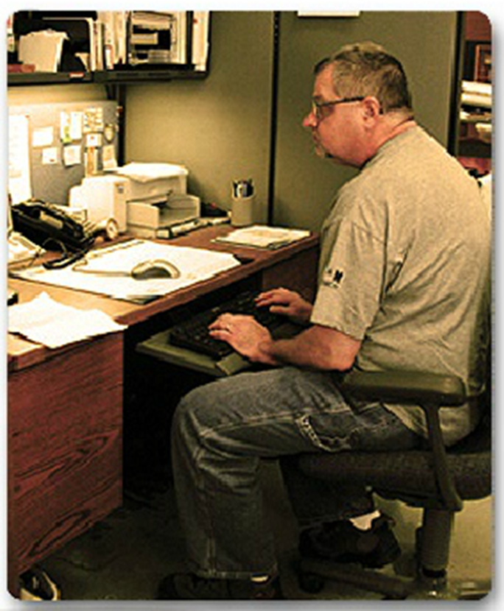

Workstation Evaluation Activity
Does this workstation meets the criteria to allow the individual to work in the neutral position?
  Meets criteria
  Does not meet criteria
Notes:
Shoulders slumped over
Upper arms and elbows are not close to the body but extended out
Forearms, wrists and hands are not straight and in-line, rather the fingers are arched up with the hand at an awkward angle to the forearm
Thighs are not parallel to the floor
Lower legs are not perpendicular as the keyboard is between the knees
Feet do not appear to rest flat on the floor

Slide 56
Stretching Exercises
Eyes
  For every 20 minutes of computer use, look at an object 20 feet away for 20 seconds
  Cup your eyes with your hands and close your eyes. Do not put any direct pressure on your eyes
  Close your eyes and gradually lower your head
  Move your eyes side to side and top to bottom
Legs
  Rotate your ankles
Upper Extremities
Extend your arms and fingers and rotate
With your arms at your sides, shake your fingers
Back
While seated, elongate your back by pretending there is a cable attached to your head that is slowly pulling upwards
Slowly pull your arms back as far as you can, trying to touch your shoulder blades together
Shrug your shoulders

Slide 57
Knowledge Check
Which risk factor for WMSDs exist in the office environment? Select all that apply.
  Posture/Position
  Force
  Duration
  Repetition
  Compression/Contact Stress
  Vibration

Slide 58
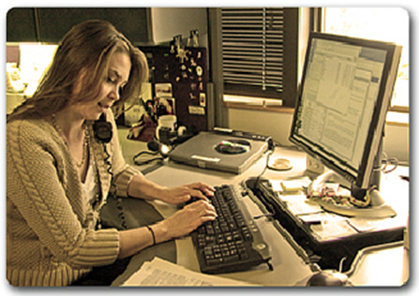
Knowledge Check
Select which modifications may reduce WMSD risk in the situation portrayed in this photo.
Standing workstations
Keyboard tray
Monitor repositioning
Monitor arm
Document holder
Telephone headsets

Slide 59
Summary
Office ergonomic risk factors found in an office setting include posture, compression, force, repetition, duration, and temperature.
Several types of equipment are available to consider when designing an office workstation to include the desk, work surface, work chair, foot rest, monitors, illumination, document holders, laptops, keyboards, input devices, and telephone headsets.
A Computer Workstation checklist can be found in 5100.23 Chapter 23.
Several visible indicators in the office can alert you as to when an employee’s workstation needs an assessment.
The Computer/electronics Accommodation Program (CAP) is available to help provide accommodations for employees with disabilities needing assistive technology.
Notes:
During this lecture you learned how to identify risk factors for work-related musculoskeletal disorders in the office setting. You also were provided with information that will help with developing solutions to reduce illness risk.

